Slide 1
Guidelines and Guardrails for AI in Healthcare
The needs of the patient come first.
Shauna Overgaard, PhD
Norwegian Centre for E-health Research
Feb 2, 2024
Notes:
I want to express my gratitude for the invitation and convey how truly privileged I am to connect with you and share some of the collaborative work advanced by our multidisciplinary teams Mayo Clinic, where the needs of the patient come first, and to represent my global colleagues at the coalition for health AI, where we continued to develop guidelines and guardrails for Ai in heath care.

Slide 2
Disclosures
I have no financial or personal disclosures
Notes:
My primary role as a Ph.D. translational scientist revolves around fostering alignment within our organization for robust AI assessment and application. I am dedicated to establishing standardized methods for creating, testing, implementing, and monitoring scalable digital solutions powered by artificial intelligence. In this capacity, I hold responsibility for harmonizing translational and regulatory aspects of our work while also actively contributing to the development of consensus at both national and international levels in the field of health AI.

Slide 3
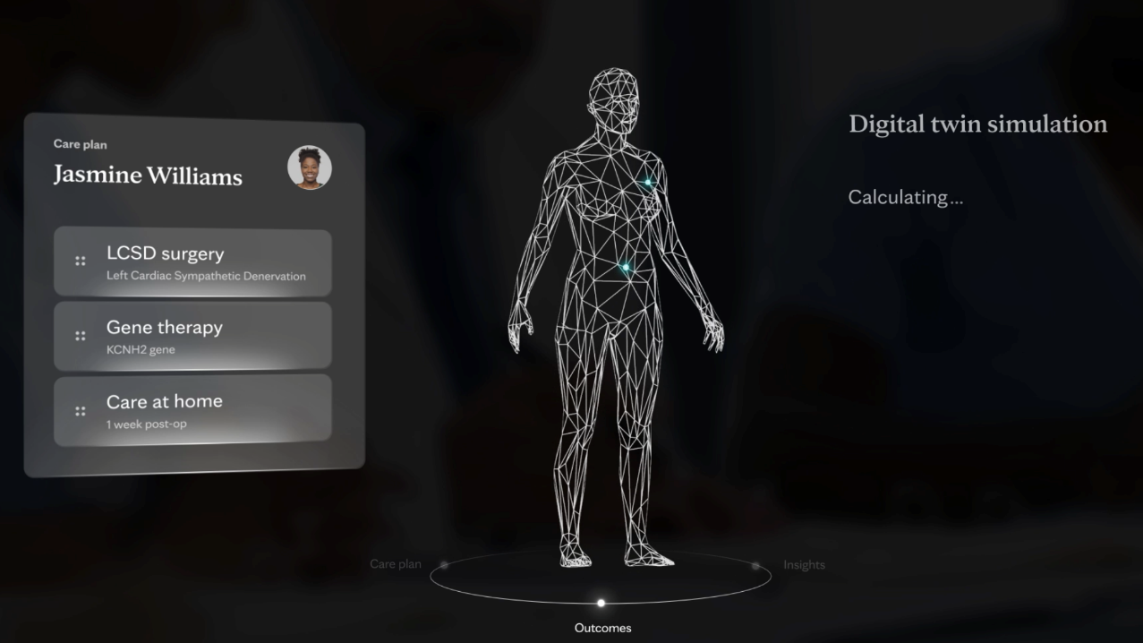
Notes:
I believe that artificial intelligence has a role in the innovation, disruption, and digital transformation of intelligent human medicine. By fostering a data centric culture, robust informatics infrastructure, and removing barriers for providers and patients to form a necessary bond, we can leverage AI to enable our providers to achieve their internal mission, and empower our patients to receive world class care.

Slide 4
Learning Objectives
Person-enabled health
01
01
Understand a foundational element of healthcare innovation.
Critique and challenge
02
Leverage scientific rigor to evaluate efficacy of disruption.
Global collaboration
03
Unite to catalyze digital transformation.
Notes:
I invite you to consider person-enabled health as a foundational element of healthcare innovation, and to critique and challenge the efficacy of disruption as it relates to AI.
Through this lens, I’ll speak to the benefit of our international collaboration in medical informatics as a means to catalyze digital innovation and help us advance equity by democratizing AI.

Slide 5
Person-enabled health
01
Understand a foundational element of healthcare innovation.
Notes:
I argue that person-enabled health is a foundational element of healthcare innovation given that our ability to meet the unique needs, values, and personalized health goals of our patients will allow them them autonomy such that they might effectively drive the course of their survival.
We as humans, will ultimately exercise control over our health. However, we must be equipped to succeed.

Slide 6
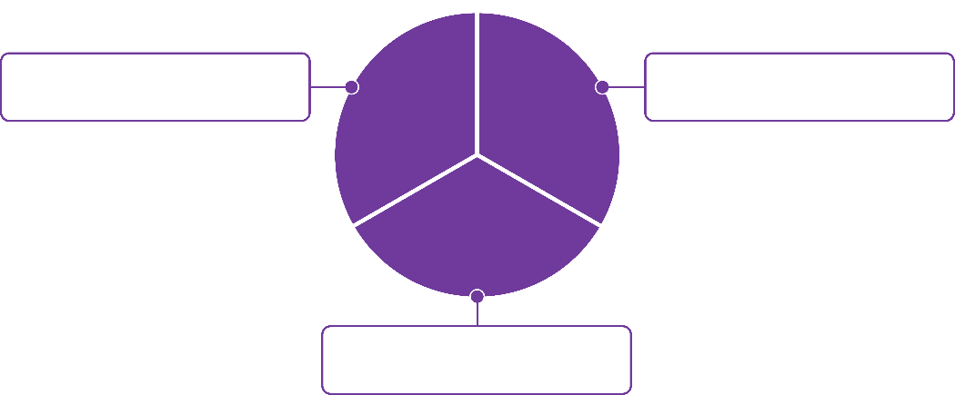
Person-Enabled Health “...meeting the individual’s needs, values, and personalized health goals.”
Health system data is mobilized and robust analytics tools track population health outcomes to anticipate risks.
Entrusts individuals to be the primary decision-makers.
Predictive
population health
Personalized healthcare delivery
Proactive risk management
Cues individuals and their provider partners on the risks and provides strategies to intervene early.
Logical Dialogue: I argue that a foundational element of healthcare innovation is person-enabled health.
Source: https://www.himss.org/resources/personalized-health-and-meeting-individuals-needs-values-and-goals-through-measurement
Notes:
Where, passive, patient-generated data are mobilized, robust AI solutions can be leveraged to anticipate risks and estimate outcomes. To measure this, three familiar components of person-enabled health are: Personalized healthcare delivery, Proactive risk management, Predictive population health.

Slide 7
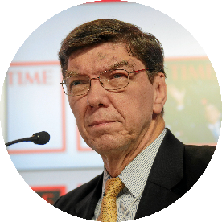
Adapting to the Digital Age “There is no single right answer or path forward, but there is one right way to frame the problem.”
Thought leader of Disruptive Innovation Theory
Introduced "disruption" in his 1997 book The Innovator's Dilemma
Dr. Clayton Christensen
Professor, Harvard Business School
April 6, 1952 - January 23, 2020
“...the most influential management thinker of his time.” – The Economist
Sustaining Innovation: satisfies customers’ current needs
Disruptive Innovation: evolve to meet customers’ future needs
Logical Dialogue: Practically, how do we frame the problem?
Photo Source
Notes:
We are innovating in not only a fast-paced digital era, but also a disruptive era, where we must nimbly evolve to the meet our patient’s future needs, as this is an era in which technology and society are evolving faster than businesses can naturally adapt.

Slide 8
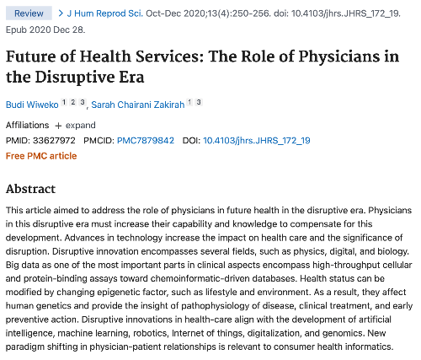
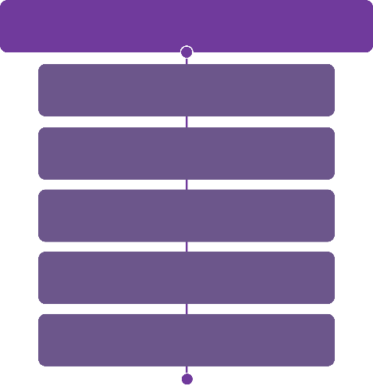
Disruptive Innovation in healthcare... evolves to meet customers’ future needs
Disruptive innovators in healthcare are aligned with the development of...
AI/ML GenAI
Robotics
IoT
Digitalization
Pharmaceutical techniques/discoveries
Wiweko B, Zakirah SC. Future of Health Services: The Role of Physicians in the Disruptive Era. J Hum Reprod Sci. 2020 Oct-Dec;13(4):250-256. doi: 10.4103/jhrs.JHRS_172_19. Epub 2020 Dec 28. PMID: 33627972; PMCID: PMC7879842. https://pubmed.ncbi.nlm.nih.gov/33627972/
Notes:
Disruptive physician innovators acknowledge that health status can be modified by changing epigenetic factors, such as lifestyle and environment and are aligned with AI, robotics, IoT, digitalization, and genomics sectors.

Slide 9
Distill the problem
Fundamental elements
Digitized individual-level information can facilitate real-time personalized insights.
It’s unreasonable to expect our patients to curate and synthesize data generated by their many elected health apps, fragmented personal genetics subscriptions, and documented clinician recommendations.
Consider clinician burnout – it's equally unreasonable to expect time-pressed providers to scour through disjointed health records to gather disparate data that may ultimately have a low probability of impacting patient outcomes.
Healthcare AI is developing exponentially, and we have traction in providing platforms for actionable insights to clinicians.
Health providers have limited contact and provide recommendations to patients at varying time intervals.
On a minute-by-minute basis, patients alone make the decisions that ultimately determine their well-being.
Logical Dialogue: Part of innovating to meet the future needs of customers, as Dr. Christensen has stated, is to frame the problem. Many of our problems adapting to the digital age in healthcare stem from "noise." What are some of the fundamental elements of this state?
Notes:
As we distill the problem of healthcare’s digital adaption to its fundamental elements, we might also acknowledge that while open access to digitized individual level information can facilitate personalized insights, it’s unreasonable to expect our patients to curate and synthesize their data. It’s equally unreasonable to expect time pressed providers to scour through disjointed records and data streams. We know from the literature that health AI is developing exponentially and we have traction in providing platforms for actionable insight to clinicians. But on a minute-by-minute basis, patients alone make the decisions that ultimately determine their well-being.

Slide 10
What system can we collectively build to prioritize the needs of our patients?
Not just their current needs, but their future needs...
Notes:
As innovators, what system can we collectively build to prioritize the needs of our patients? Again, not simply their currently needs, but what do we anticipate will be their future needs?

Slide 11
Predictive Analytics | Machine Learning | Proactive and focused decision-making
Example of Machine Learning Algorithm | Basic Definition | Example of Application in a real-world healthcare setting
Cluster Analysis | An unsupervised learning technique where the results are grouped by some similar criterion. | Identifying subgroups of patients with similar patterns of comorbid conditions for targeted care management.
Decision Tree | A graphical method to display all possible outcomes using 'branches.' Analogous to a tree where each leaf is a possible outcome. | Risk factor variables input and evaluated to predict cesarean delivery.
Deep Learning | Modeled after neural networks in the brain, a computer is trained to figure out a problem rather than having the answers programmed into it. | Detection of skin cancer and diabetic retinopathy through image evaluation.
Regression | A supervised learning prediction method, where the independent and dependent variables are real or integers and the relationship between the variables is determined. | Estimates of the probability of patient readmissions by modeling factors influencing the demand for emergency department services to predict patient readmissions.
Notes:
I believe that AI and a supporting infrastructure can adapt to meet the current and future needs of patients. And while still relatively immature in healthcare, we seen notable evidence of AI’s potential in deep learning and large language models.

Slide 12
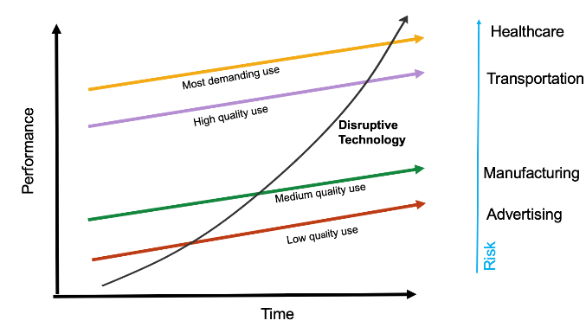
Comparison of AI Adoption Across Sectors
Original Concept: Christensen, C., McDonald, R., Altman, E., & Palmer, J. (2018). Disruptive Innovation: An Intellectual History and Directions for Future Research. Journal of Management Studies, 55(7). doi:10.1111
Logical Dialogue: AI is a disruptive technology that has been adopted by other sectors, however, AI is slow to be adopted in healthcare given that the performance must match the risk of the technology. Consider the potential risk of implementing and leveraging AI in each of these sectors. Where AI is a disruptive technology, its performance must meet the highest standards for adoption in domains highest potential risk.
Notes:
However, AI as a disruptive technology has been more readily adopted by other sectors. This is unsurprising, as a sectors rate of adoption of disruptive technology is a function of the potential risk of that technology. In healthcare, we require and advocate for the highest standards for testing and adoption because we are a domain of the highest potential risk.

Slide 13
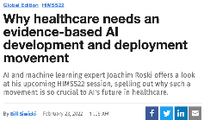
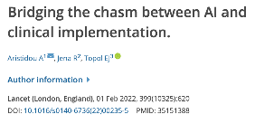
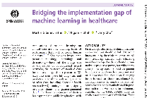
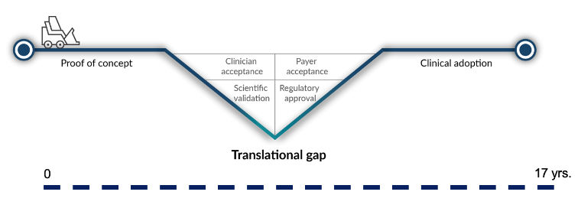
Translation Gap
Morris ZS, Wooding S, Grant J. The answer is 17 years, what is the question: understanding time lags in translational research. J Roy Soc Med. 2011;104:510–20. doi: 10.1258/jrsm.2011.110180 || Balas EA, Boren SA. Managing clinical knowledge for health care improvement. Yearbook of Medical Informatics. Schattauer: Stuttgart; 2000. pp. 65–70. || Translational gap diagram from ©Biosci Consulting || Slide Credit: Dr. Barbarra Barry
Notes:
And indeed, the field has recognized a translation gap, where there are many AI models much of the work published as potential AI solutions hasn’t materialized in the real world. but there is research to indicate that scientific evidence is the language of trust in healthcare.

Slide 14
Critique and challenge
02
Leverage scientific rigor to evaluate efficacy of disruption
Notes:
As innovators, and global collaborators we can help close this gap.

Slide 15
"We must be willing to remodel, convert, reeducate and retrain to meet merging needs, not waiting until they are overpowering, but treating them while they can be contained, (and) we must retain the proven treatment."
- Sister Mary Brigh Cassidy
Notes:
But we must be willing to remodel, convert, reeducate and retrain to meet merging needs, not waiting until they are overpowering, but treating them while they can be contained.

Slide 16
Translational Science: Code to Bedside
Translation from Code to Bedside
The process by which the results of research done at the computer are used to address patient needs.
*A solid AI translational process should enable stakeholders by addressing transparency, reproducibility, ethics, and effectiveness.
Notes:
At mayo clinic we are targeting this chasm between code and bedside through translational science, by uniting and enabling stakeholders to address the transparency, reproducibility, ethics, and effectiveness of AI.

Slide 17
Opportunities to bridge chasm
Barriers | Opportunities
If a machine-learned model is trained using data that do not match the data it will encounter when deployed, its performance may be lower than expected. | Work with data science teams to plan testing and deployment
Research results cannot be easily transferred to a clinical environment. AI and Healthcare sides have a broad gap around technology, funding, and people. | Work across enterprise to identify internal gaps in translation, identify technology needs and personnel.
AI systems have a low probability of providing real clinical benefits unless physicians can balance trust and skepticism. If physicians do not trust the technology, they will not use it. Blind trust in the technology can lead to medical errors. | Apply rigorous testing to algorithm and test for utility, adoption, and scalability. Partner with AI Ethicists to understand, promote, and sustain user trust in AI.
Lack of implementation of evidence-based, well-documented, AI development or deployment practices to facilitate translation, suitability, adaptability. This is analogous to erratic reliance on evidence-based clinical practices in healthcare. | Research and develop best practices. Publish findings, partner with regulatory team.
Notes:
We are systematically targeting opportunities to bridge the chasm at our institution by forming interdisciplinary teams across the enterprise representative of the AI lifecycle and leveraging translational informaticians to develop and apply rigorous, comprehensive evaluation of our models and AI solutions.

Slide 18
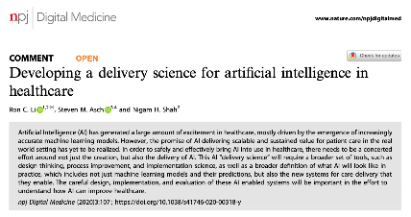
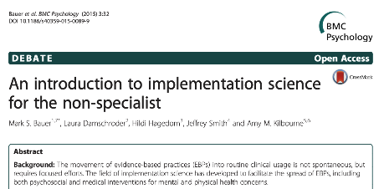
A Delivery Science for Implementing AI in Heath Care
“To address how AI can be leveraged at scale, we need to both broaden and deepen our thinking around how AI fits into the complexities of healthcare delivery. As the data and computer sciences for developing AI based solutions have matured, we now need a delivery science to bring those solutions into use in healthcare.”
Notes:
Part of our translational science approach is a delivery science, or implementation science, “the scientific study of methods to promote the systematic uptake of research findings into practice, and, hence, to improve the quality and effectiveness of health services.”
Bauer MS, Damschroder L, Hagedorn H, Smith J, Kilbourne AM. An introduction to implementation science for the non-specialist. BMC Psychol. 2015;3(1):32. Published 2015 Sep 16. doi:10.1186/s40359-015-0089-9 https://bmcpsychology.biomedcentral.com/articles/10.1186/s40359-015-0089-9
Eccles MP, Mittman BS. Welcome to implementation science. ImplementationSci.
2006;1:1. (Field estblsihing article) https://implementationscience.biomedcentral.com/articles/10.1186/1748-5908-1-1
Li, R. C., Asch, S. M., & Shah, N. H. (2020). Developing a delivery science for artificial intelligence in healthcare. npj Digital Medicine, 3(1), 107. doi:10.1038/s41746-020-00318-y https://www.nature.com/articles/s41746-020-00318-y

Slide 19
Evaluation Process Standardization for AI Translation
Leveraging Clinical Research Pathway
Phase | Prepare 0: Discovery & Intervention | Develop 1: Technical Performance & Safety | Validate 2: Efficacy & Side Effects | Deploy 3: Therapeutic Efficacy | Maintain 4: Safety & Effectiveness
AI Evaluation Priorities | Data Quality Evaluation User-centered design work and user requirements for sustainability and scalability. | Model development SaMD Review; IRB & FDA regulatory determination Model ethical and explainability assessment UX design research & prototype design Deployment feasibility analysis PCED submits the endorsed EHR Enhancement Request AI ethics & bias evaluation | Iterative interface design with stakeholder focus groups Silent evaluation/pre-pilot model performance & validation Model implementation evaluation & validation Business plan validation & deployment planning | Prospective study/pragmatic trial Clinical validation Operational education | Post-deployment surveillance & maintenance plan Corrective & preventative action model documentation Fidelity/surveillance of clinical utility
AI Evaluation & Stewardship Checkpoint | Patient impact Clinical practice & business impact Societal impact Purpose & indications Model planning & architecture Historical bias evaluation Representation bias eval | Risk assessment Model accuracy evaluation Usability formative Measurement bias evaluation Learning bias evaluation | Silent evaluation Model statistical validation Deployment validation planning Aggregation bias evaluation | Clinical validation User education & training plan Monitoring & reporting plan Corrective & preventative action plan Deployment bias eval | Post-deployment maintenance Quality monitoring & audit maintenance De-implementation Continual bias evaluation plan
Artificial Intelligence Translation in Health Care: Framework for Evaluation and Documentation. Overgaard, et al. [V2 in progress] V1 publication: https://pubmed.ncbi.nlm.nih.gov/35854754/
Notes:
This includes the development and adaptation of an evaluation process standard for ai translation.

Slide 20
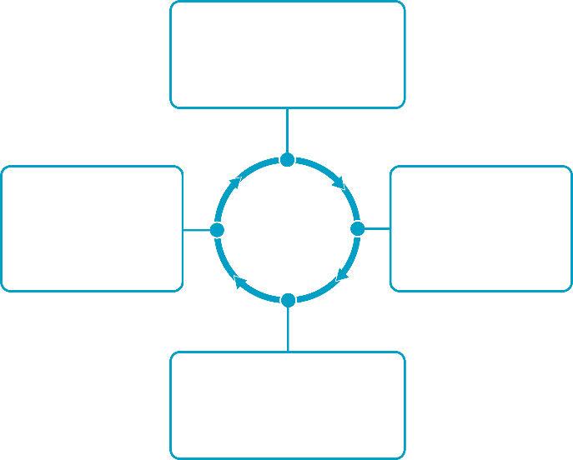
AI/ML Documentation
Accountability
Clarity about who is responsible for the outcomes of technology use, for when things go wrong, and how they should be held to account (IEEE)
Primary values driving model documentation framework: explainability, transparency, accountability, trustworthiness
Harmonizes AI development and ethical considerations
Complements and works in tandem with model development
Communicates model components and features
Addresses limitations and risks
Avoids complex "black-box" models
Value and document transparency and accountability in model development to standardize explainable AI and gain trust
Explainability
Transparency
Extent to which information is made transparently available to stakeholders can be readily interpreted and understood (IEEE)
Transfer of truthful, relevant information presented at a level & in a meaningful form from autonomous system or designers to stakeholders (IEEE)
Model
Documentation
Trustworthiness
Earns & sustains user engagement & confidence, which is crucial for successful model application; created & maintained in three ways: Human Trust, Technical Trust, and Regulatory Trust (CTA and ANSI)
Sources: ethical-dilemmas-in-ai-report.pdf / ANSI/CTA "The Use of Artificial Intelligence in Health Care: Trustworthiness"
Notes:
We’re also developing a transparent model documentation framework to facilitate ai translation, to work in tandem with regulatory documentation requirements and facilitate knowledge continuity across multidisciplinary stakeholders throughout the ai life cycle.

Slide 21
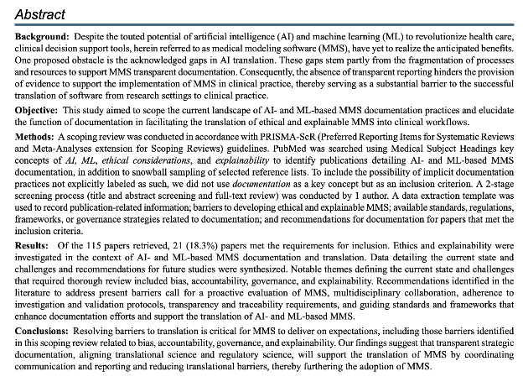
AI Transparency
Notes:
As healthcare institutions such as the Mayo Clinic venture into SaMD development and commercialization, the presence of a cohesive system that fosters innovation without undue impediments can be of great importance. Our findings suggest that aligning translational and regulatory science through strategic documentation developed to promote proactive evaluation, multidisciplinary collaboration, investigation and validation protocols, transparency and traceability requirements, and guiding standards and frameworks will support the translation and adoption of MMS. Further, we propose that leveraging such transparent documentation processes through a quality management system may support enterprise coordination toward developing an SaMD regulatory framework.

Slide 22
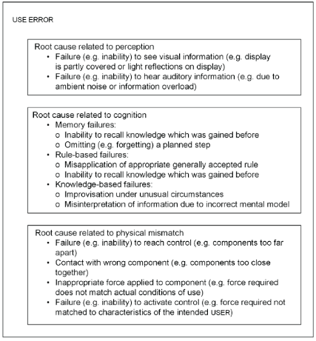
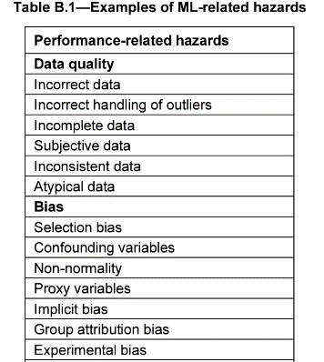
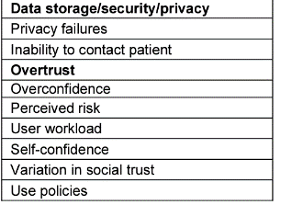
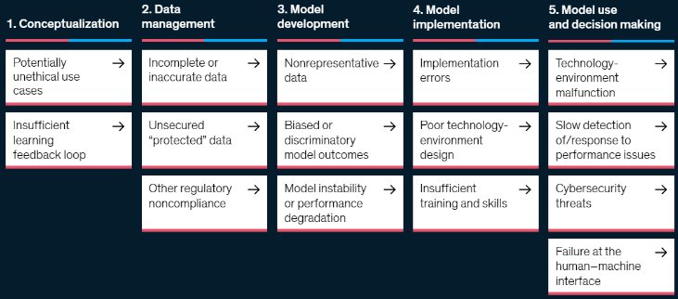
AI/ML RISKS
IEC 62366-1: 2015
TIR34971:2023
https://www.mckinsey.com/business-functions/quantumblack/our-insights/confronting-the-risks-of-artificial-intelligence
Evaluate and consider AI/ML risks for downstream impact
Credit: Mayo Clinic Center for Digital Health AI Enablement Team
Notes:
Utilize expertise in informatics, clinical workflow, and ethics to adopt an integrated approach in cutting-edge product development. This approach aims to tackle concerns such as fairness, transparency, and intelligibility, with specific examples of AI risks linked to sample bias (associated with 34971) and human-machine interface failures (related to 62366).
Teams can learn answer risk-based considerations – such as
1. Does the training/validation dataset accurately represent the target population?
2. Could unknown or uncollected patient characteristics introduce bias or errors?
3. Are there alternatives for users who do not meet the intended criteria?
4. Do end users comprehend how to interpret AI outputs, given their varying levels of expertise?
5. Can patients opt out of data collection for AI/ML solutions after initially giving consent?
These considerations also extend to post-production activities, including monitoring for data drift using predefined risk thresholds. Tracking misuse and misguided trust may involve analyzing user interactions, time spent on instructions for use (IFU), and historical actions, which can inform training intervals. Additionally, usability and human factors (utilizing tools like 62366) guide the design and anticipate potential misuse scenarios."

Slide 23
Examples of AI Bias Sources (non-exhaustive list)
Biases in study inclusion criteria, e.g., using eGFR to select study participants
Study data collection biases (including misclassification of race/ethnicity)
Lack of representation / selection in the dataset
Missing data
Biases in imputed data
Biases in learning and training data
Collapsing race variables
Lack of reporting for methodological approach
Insufficient sample size
Labeling bias
Overfitting
Lack of reporting for methodological approach
Interpretation bias
Correlation bias
Training-validation data skew
Lack of external validation
Lack of performance assessments, such as calibration and discrimination
Lack of reporting for methodological approach
Notes:
High-quality data is the first step towards successful use of artificial intelligence in healthcare. A major barrier to a data’s quality is bias.

Slide 24
Data Generation Bias Considerations
Bias Type | Risk Description | Potential Mitigation | Resources
Historical/preexisting | Existing societal stereotypes reflected in datasets. | Debiasing Variational Autoencoder | Amini et al., 2019
Representation | Nonrepresentative data for population leading to systematic errors in ML model predictions. | Targeted data augmentation | Sontag & Johanssen, 2018
Measurement/cognitive | Chosen features and labels are imperfect proxies for the real variables of interest | Exchanging with domain experts about features | Baer 2019
Notes:
For instance, as we generate data, historical, or preexisting Bias, are existing societal stereotypes reflected in the data sets.
Representation bias, occurs when data used are nonrepresentative of the clinical population leading to systematic errors in ML model predictions.
And measurement bias, where chosen features and labels are imperfect proxies for the real variables of interest.
For a more in-depth review, here are some examples of potential mitigation strategies to minimize the risk of harm associated with data generation bias types.

Slide 25
Model Building and Implementation Bias Considerations
Bias Type | Risk Description | Potential Mitigation | Resources
Learning | Amplification of performance disparities | Reevaluate model design choices | Hooker, 2021
Aggregation | Incorrect assumption that mapping from inputs to labels is consistent across subsets of the data. | Coupled Learning Methods | Dwork et al., 2018
Evaluation | A non-representative testing population or inappropriate performance metrics are used to evaluate the ML model. | Representativeness of Benchmark Dataset Subgroup Validity | Ryu et al., 2017 Suresh & Guttag, 2019
Deployment | The ML model is used and interpreted in a different context than it was built for. | Holistic Evaluation Monitoring Plan & Human Supervision | Estiri et al., 2022 Giffen et al., 2022
Notes:
There are also model building and implementation sources of harm throughout the machine learning life cycle. For instance, learning bias is the amplification of performance disparities. Aggregation bias, is inserted with the incorrect assumption that mapping from inputs to labels is consistent across subsets of the data. Evaluation bias may occur when the non-representative testing population or inappropriate performance metrics are used to evaluate the ML model. Deployment bias may inserted be when the ML model is used and interpreted in a different context than it was built for. Here we share some examples of potential mitigation strategies to minimize the risk of harm associated with these bias types.

Slide 26
Enterprise AI Translation Advisory Board
Objective & Scope
Develop and deploy meaningful AI models into the Mayo Clinic Practice by streamlining organizational processes to assess the implementation/integration of all AI models into the clinical workflow.
To meet this objective, we have formed an easily accessible multidisciplinary advisory group of experts to: a) assess the feasibility of AI to solve the problem (right fit) b) assess the risk of patient harm, clinical benefit, and cost/return on investment c) assess the technical and operational feasibility of proposed AI solution d) guide the implementation of AI including appropriate approvals within Mayo Clinic
Video - The Enterprise AI Translation Advisory Board: An Introduction
Notes:
Our enterprise stance is that the prioritization of testability, usability, and safety of machine learning based solutions is critical to their successful translation. Under the direction of the clinical systems oversight committee, we’ve formed an enterprise-wide cross functional team of experts, representative of all stages of the AI lifecycle to critically evaluate the feasibility of AI to solve the problem, the risk of patient harm, technical and operational feasibility, and if appropriate to guide the testing and implementation within the Mayo Clinic practice. To systematize scientific rigor in this work, we are concurrently developing streamlined processes, frameworks, and tools to develop trustworthy, explainable, and responsible AI and accelerate translation of AI into clinical practice.

Slide 27
ENGAGEMENT PROCESS
Initial Consultation
Contextual Research
Board and Stakeholder Convening
Enterprise AI Translation Advisory Board Meetings
Viability Report Presentation
Evaluation Plan
First meeting with project stakeholders and subgroup of the Board to understand the problem, background, primary tool functionality, and expected outcomes and clinical impact
Conduct clinical shadowing and workflow evaluations, evaluate potential AI-output and actions, determine user needs, and solicit feedback from clinical staff and stakeholders, as well as perform a brief regulatory and literature review
Evaluation questions such as "Is this an AI problem?" and "Are there internal efforts or commercially available solutions like this?" will be documented to provide the Board with sufficient materials to begin a formal evaluation
Meeting with project stakeholders and Board to discuss the project and facilitate discussions between groups needed to identify barriers and provide relevant recommendations
Board specific meetings to a) assess the feasibility of AI to solve the problem, b) risk of patient harm, clinical benefit, and cost/ROI, c) assess the technical/operational feasibility, and d) guide the implementation of AI including appropriate approvals
Board presentation to project stakeholders to communicate findings and recommended next steps to support the implementation and integration into the clinical workflow
Not all projects will advance to a full board review. Board review limited to projects that satisfy the following criteria: Completed Initial Consultation (Available Evaluation Plan), Endorsed by Clinical Practice (Evidence of potential practice impact), Model available for evaluation and indexing
Notes:
Some of this work is through our engagement process - Wherein we also work with our software as a medical device review board to provide initial consultation, contextual research, and evaluation plan, and then our board members present to our stakeholders the ability to translate the work into clinical settings.

Slide 28
A Commitment to Health equity
https://health.google/health-equity/
Notes:
Through our partnership with Google health, we are activating health equity to provide insights to improve patient outcomes, curb excessive costs, and accelerate value-based care.

Slide 29
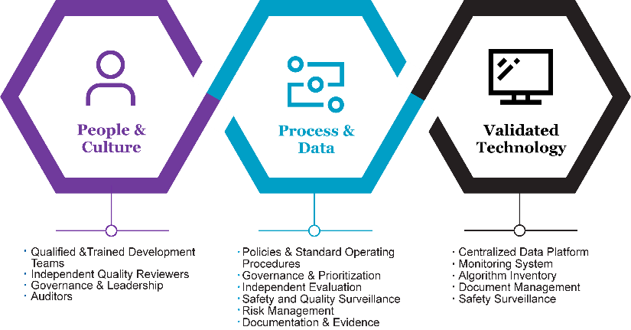
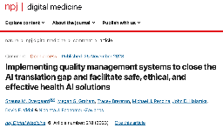
Implementing Quality Management Systems to Close the AI Translation Gap: Facilitating Safe, Ethical, and Effective Health AI Solutions
Primary components of a Quality Management System (QMS)
https://www.nature.com/articles/s41746-023-00968-8
Notes:
We are also aligning translational science and regulatory science and implementing quality management systems to facilitate safe, ethical, and effective health ai solutions. To do this we consider, what policies, processes, procedures, and accountability structures are in place to identify and mitigate AI risk.
And through the integration of Quality Management System (QMS), we are establishing a robust framework that accelerates the safe, ethical, and effective delivery of AI/ML in day-to-day patient care to evolving with regulations and minimize redundancy and rework while aligning our internal governance practices with our steadfast commitment to scientific rigor and medical excellence.

Slide 30
Building a healthcare AI framework hub and spoke model
Credit: Mayo Clinic Center for Digital Health AI Enablement Team
Notes:
Risk management plans address safety, bias, and other foreseen risks during software implementation. Continuous monitoring, reporting, and evaluation post-deployment ensure ongoing safety. Feedback, monitoring, and corrective/preventive actions are vital for issue identification, escalation, root-cause analysis, and risk management while enhancing AI technology.

Slide 31
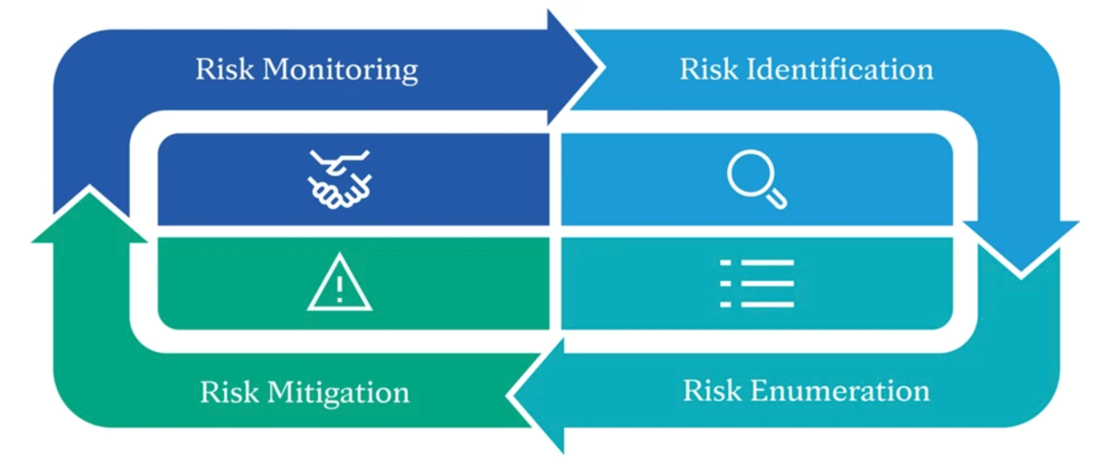
Notes:
This approach hinges on a proactive risk management plan tied to intended use, involving identification, enumeration, mitigation, and ongoing monitoring of potential hazards arising from healthcare software or its impact on clinical workflows. During software development, risk mitigation features are integrated, including improvements in user experience and comprehensive user training.

Slide 32
Notes:
And in collaboration industry, academic, and government partners, such as the national institutes for health, the national academy of medicine, NIST we have formed a coalition for health ai to develop core principles intended to guide evaluation criteria and standards of development. This work is being positioned globally and we have begun to catalog evaluation criteria with the goal to produce a stakeholder-driven implementation guide to drive the credible and transparent use of health AI technologies, reducing variation in current evaluation, monitoring, and reporting methods.

Slide 33
“We must not be content only to see things as they are. We must have the vision, faith, and hope to see what things can and must become.”
- Sister Generose
Notes:
At mayo clinic we are not content only to see things as they are, like you we aim to have the vision, faith and hope to see what things can and must become.

Slide 34
Global Collaboration
03
Unite to catalyze digital transformation

Slide 35
CHAI Purpose
Form a diverse community across AI lifecycle
Harmonize standards and reporting
Educate end-users on AI evaluation
Provide guidelines to:
Ensure high-quality care
Increase credibility amongst users
Meet healthcare needs
Develop a framework with Health Equity in mind to help address algorithmic bias
Notes:
Mayo Clinic's efforts are integrated into the Coalition for Health AI's work, allowing us to implement consensus-based recommendations from the broader community. CHAI's mission is to provide guidelines for the evolving health AI landscape to enhance care quality and credibility and meet healthcare needs. We are also developing equity-focused assurance frameworks to ensure data quality data and mitigate algorithmic bias.

Slide 36
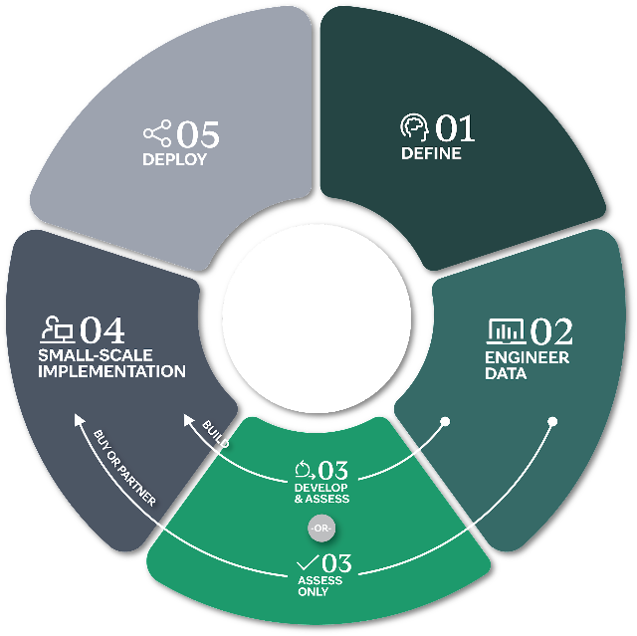
Addressing Bias in Healthcare Decision-Making
Consider Bias Sources:
Identify bias origins at different stages of the AI life cycle
Targeted Solutions:
Use specific metrics and tailored approaches.
Standardized Assurance Framework:
Incorporate equity analysis and bias mitigation.
Notes:
For example, we focus on addressing bias in the model development cycle, utilizing tailored metrics and approaches for equity analysis and mitigation. This effort aims to provide stakeholders with insights into how bias can impact healthcare decisions and outcomes. Transparent documentation is a major part of this work.

Slide 37
CHAI Goal & Objectives
Goal:
Develop “guidelines and guardrails” for credible, fair, and transparent health AI systems.
Objectives:
Define core principles and criteria for health AI
Standardize health AI transparency
Notes:
In pursuit of its mission, CHAI aims to establish guidelines and standards for adopting reliable, equitable, and transparent health AI systems to advance healthcare quality. Our objectives include developing a consensus-driven framework that defines core principles and criteria for health AI developers, end-users, and healthcare organizations to assess, monitor, and report on health AI systems throughout their lifecycle. We’ve adopted a risk-based approach aligned with NIST. Additionally, CHAI aim to create and promote a standardized labeling system that enhances transparency for health AI end-users and consumers, ultimately bolstering the credibility of health AI systems.

Slide 38
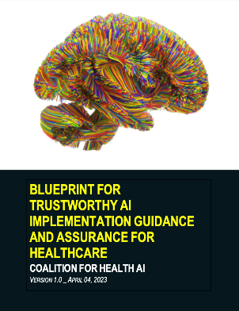
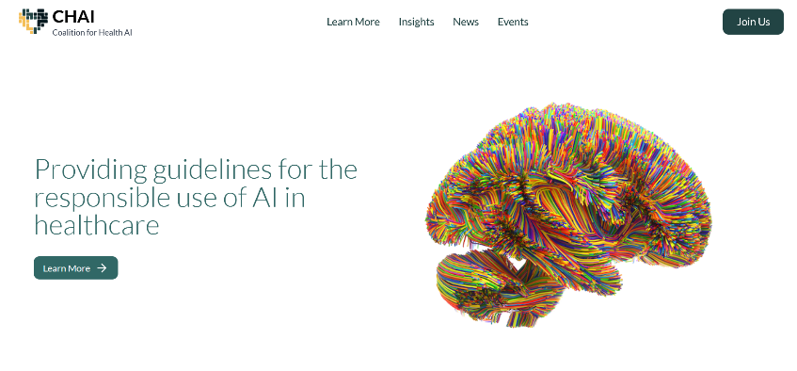
The CHAI Blueprint for Trustworthy AI
https://www.coalitionforhealthai.org/
https://www.coalitionforhealthai.org/papers/blueprint-for-trustworthy-ai_V1.0.pdf
Notes:
We’ve released a blueprint for Trustworthy AI in healthcare, influenced by discussions with developers, clinicians, and other stakeholders in AI-enabled patient care. The paper is available on the CHAI website at coalitionforhealthai.org under Insights.

Slide 39
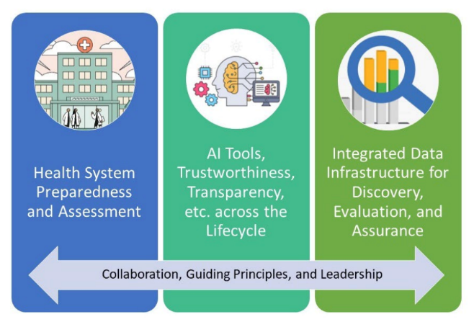
Key CHAI Blueprint Findings
A consensus-based framework can help ensure equity and access to trustworthy health AI for patients across different health systems, including small, rural, and/or resource-constrained ones.
Using a common set of principles to build and facilitate the use of AI tools is necessary
An independent assurance lab can evaluate processes and tools submitted by health systems, tool developers, and vendors to ensure the ethical use of AI.
© 2023 Duke University School of Medicine. All rights reserved.
Notes:
You’ll see that findings in the blueprint emphasize the need for structured health system assessment, AI tools to reduce bias and enhance transparency, an integrated data infrastructure, and the potential role of an advisory body to ensure equitable access to trustworthy health AI, especially in underserved areas. In the document, common principles for AI development are stressed to promote interoperability and data integrity. Independent assurance labs are proposed to objectively review processes and tools for ethical AI use.

Slide 40
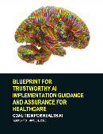
Key CHAI Blueprint Recommendations
Establish an assurance lab and advisory service
Demonstrate the AI value proposition
Develop structured checklists and maturity models
Create registries of AI tools
Leverage sandboxes for local testing
Develop evaluation and monitoring platforms
Notes:
The Blueprint also offers strong recommendations for establishing a reliable AI ecosystem in healthcare. Key components include an assurance lab, advisory service infrastructure, shared value definition, tool registries, legal templates, and sandbox environments. Implementing these elements builds a strong foundation for AI deployment. Demonstrating AI's value to patients and healthcare organizations is vital. Checklists and maturity models help assess AI tool potential and organizational readiness. Tool registries empower providers and enhance precision medicine. Sandboxes and monitoring platforms ensure long-term reliability, bias detection, and performance assessment. These recommendations guide trustworthy AI implementation in healthcare.

Slide 41
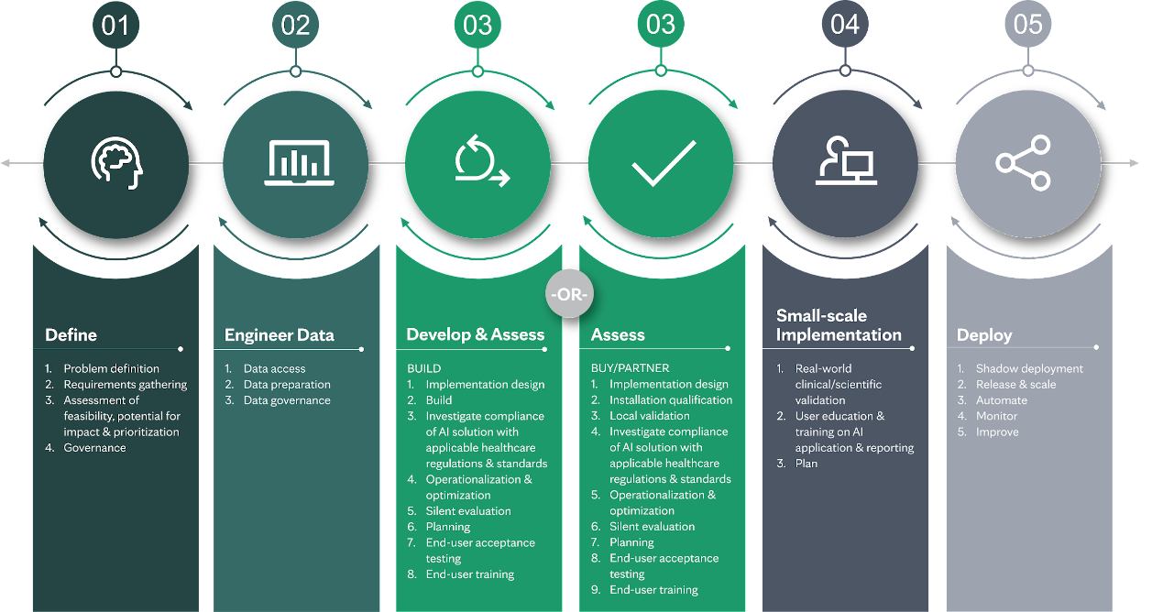
Notes:
We are developing a consensus-driven AI life cycle based on feedback from our working groups;
The coalition's members represent a diverse community across the AI lifecycle, who have come together to harmonize standards and reporting for health AI and educate end-users on how to evaluate these technologies to drive their adoption.

Slide 42
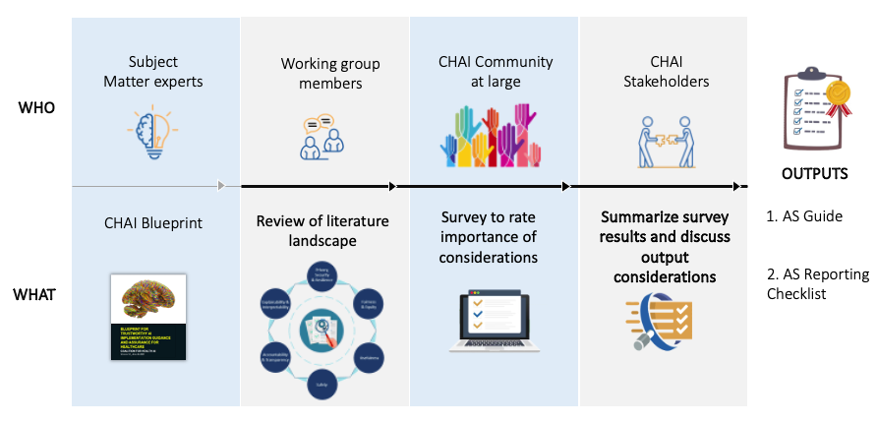
Notes:
As we develop these consensus-based work products, it's evident that the growing availability of model-development technology and community consensus on performance evaluation highlights the need for a 'testing lab' to ensure model credibility and accountability. We urgently require a nationwide public-private partnership to establish standardized evaluation procedures for health AI models, ensuring fairness, validity, safety, and ongoing performance assessment across diverse clinical settings and populations.

Slide 43
Notes:
We advocate for standardized evaluation procedures for health AI models, ensuring fairness, validity, and safety in diverse clinical settings and populations. Specifically, we propose a network of health AI assurance labs to enhance transparency, reliability, and credibility.

Slide 44
CHAI Future Focus Areas
Standards and Tools Assurance Guide
Technical Implementation Guide
Extended scope and best practices for pharma, devices and payers
Safety surveillance
and monitoring
Health AI Community
and Outreach
Catalog of transparency information
Large Language Models (LLMs) and
Other Use Cases
Public-Private Partnership
Maturity Model
Health System’s AI Readiness
Network of Assurance Lab
Democratizing and
implementation
Notes:
Thus, CHAI, which includes government entities as observers and collaborates closely with the National Academy of Medicine's AI Code of Conduct initiative, anticipates leading a nationwide dialogue to shape the creation, implementation, and operation of such assurance labs, contributing to the responsible advancement of healthcare AI.

Slide 45
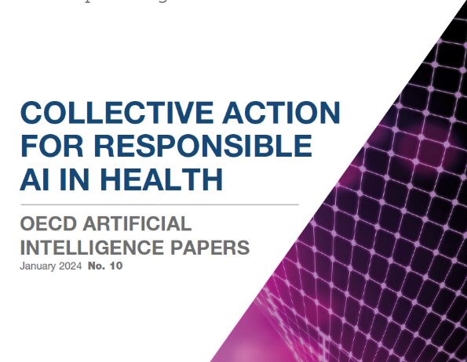
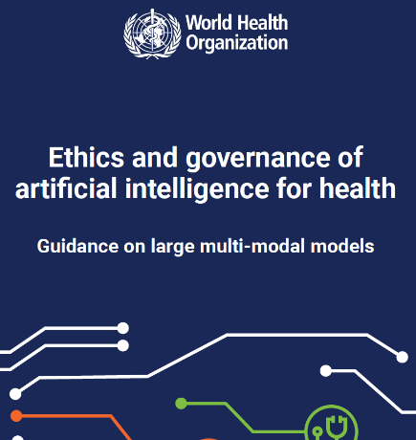
consensus ethical principles for use of AI for health
https://www.oecd.org/publications/collective-action-for-responsible-ai-in-health-f2050177-en.htm
https://www.who.int/publications/i/item/9789240084759
Notes:
We eagerly anticipate our continued collaboration with you in advancing ethical principles for the use of AI in healthcare.

Slide 46
We welcome your involvement!
https://coalitionforhealthai.org/join-us
Notes:
And we welcome you to join us as we take our next steps in developing guidelines and guardrails for AI in healthcare.

Slide 47
References (1/2)
Harini Suresh and John Guttag. 2021. A Framework for Understanding Sources of Harm throughout the Machine Learning Life Cycle. In Equity and Access in Algorithms, Mechanisms, and Optimization (EAAMO '21). Association for Computing Machinery, New York, NY, USA, Article 17, 1–9. https://doi.org/10.1145/3465416.3483305
Overgaard SM, Peterson KJ, Wi CI, et al. A Technical Performance Study and Proposed Systematic and Comprehensive Evaluation of an ML-based CDS Solution for Pediatric Asthma. AMIA Annu Symp Proc. 2022;2022:25-35. Published 2022 May 23. https://pubmed.ncbi.nlm.nih.gov/35854754/
Alexander Amini, Ava Soleimany, Wilko Schwarting, Sangeeta Bhatia, and Daniela Rus. Uncovering and mitigating algorithmic bias through learned latent structure. AAAI/ACM Conference on Artificial Intelligence, Ethics, and Society. 2019. https://static1.squarespace.com/static/5e96377a2c8aee64d168790e/t/6193f15d3ab904678ab86953/1637085537126/Amini+-+2019.pdf
Sontag, David and Johansson, Fredrik D. 2018. "Why is my classifier discriminatory?." Advances in Neural Information Processing Systems, 2018-December. https://dspace.mit.edu/bitstream/handle/1721.1/137319/NeurIPS-2018-why-is-my-classifier-discriminatory-Paper.pdf?sequence=2&isAllowed=y
Baer, Tobias. Understand, manage, and prevent algorithmic bias: A guide for business users and data scientists. New York, NY: Apress, 2019. https://link.springer.com/book/10.1007/978-1-4842-4885-0
Hossein Estiri, Zachary H Strasser, Sina Rashidian, Jeffrey G Klann, Kavishwar B Wagholikar, Thomas H McCoy, Jr, Shawn N Murphy, An objective framework for evaluating unrecognized bias in medical AI models predicting COVID-19 outcomes, Journal of the American Medical Informatics Association, Volume 29, Issue 8, August 2022, Pages 1334–1341, https://doi.org/10.1093/jamia/ocac070

Slide 48
References (2/2)
H., & Guttag, J. V. (2019). A framework for understanding unintended consequences of machine learning. arXiv preprint arXiv:1901.10002.
Cynthia Dwork, Nicole Immorlica, Adam Tauman Kalai, and Max Leiserson. 2018. Decoupled Classifiers for Group-Fair and Efficient Machine Learning. In Proceedings of the 1st Conference on Fairness, Accountability and Transparency (Proceedings of Machine Learning Research, Vol. 81), Sorelle A. Friedler and Christo Wilson (Eds.). PMLR, New York, NY, USA, 119–133. http://proceedings.mlr.press/ v81/dwork18a.html
Sara Hooker. 2021. Moving beyond “algorithmic bias is a data problem”. Patterns 2, 4 (2021), 100241.
ANSI/CTA-2090 The Use of Artificial Intelligence in Healthcare: Trustworthiness (ANSI/CTA-2090). https://shop.cta.tech/products/the-use-of-artificial-intelligence-in-healthcare-trustworthiness-cta-2090
Brereton TA, Malik M, Lifson MA, Greenwood JD, Peterson KJ, Overgaard SM. The Role of AI Model Documentation in Translational Science: A Scoping Review. medRxiv. 2023:2023.01.21.23284858. doi:10.1101/2023.01.21.23284858. https://www.medrxiv.org/content/10.1101/2023.01.21.23284858v1
Brereton TA, Overgaard, SM, et al., A Proposed Model Documentation Framework to Faciliate Translation of AI Models in Healthcare. CIC AMIA 2022; Inivted for Applied Clinical Informatics Special Issue (under review). Model Documentation Framework Prototype: https://docs.google.com/spreadsheets/d/1jenXP5miRxcteV6XRU71e-A7sJB46Ztz/edit?usp=sharing&ouid=101115941916710306157&rtpof=true&sd=true
Coalition for Health AI: Blueprint for Trustworthy AI Implementation Guidance and Assurance for Healthcare: https://www.coalitionforhealthai.org/insights
National Institute of Standards and Technology, AI Risk Management Framework: https://www.nist.gov/itl/ai-risk-management-framework

Slide 49
tusen takk!
Notes:
Thank you

